Slide 1
Laparoscopic Transcystic Common Bile Duct Exploration
24 April 2024
Source: SAGES, Clinical Spotlight Review: Laparoscopic Common Bile Duct Exploration, DEC 2017

Slide 3
Background
Choledocholithiasis is present in 10-15% of patients undergoing cholecystectomy for uncomplicated, symptomatic cholelithiasis
Normal exams on ERCP not infrequent
ERCP complications include pancreatitis, hemorrhage, perforation, and cholangitis
ERCP limited to specialized centers in patients with RYGB
Combined cholecystectomy/LCBDE may decrease LOS and cost
Success rate among surgeons who perform LCBDE is ~90%

Slide 4
Indications
CBD stones identified on workup (MRCP, US) or during IOC
One/multiple stones
Stone < 6 mm diameter*
Cystic duct diameter > 4 mm
Cystic duct entrance to CBD is lateral

Slide 5
Contraindications (relative or absolute)
Stones > 6mm
Intrahepatic stones
Cystic duct diameter < 4 mm
Cystic duct entrance to CBD is posterior or distal (should enter laterally in order to proceed)

Slide 6
Equipment (1)
Fluoroscopy
Super Sheath CBDE
12F
Able to accommodate a 0.035 inch guidewire
Glucagon 1 to 2mg IV
Fogarty-type balloon-tipped catheters

Slide 7
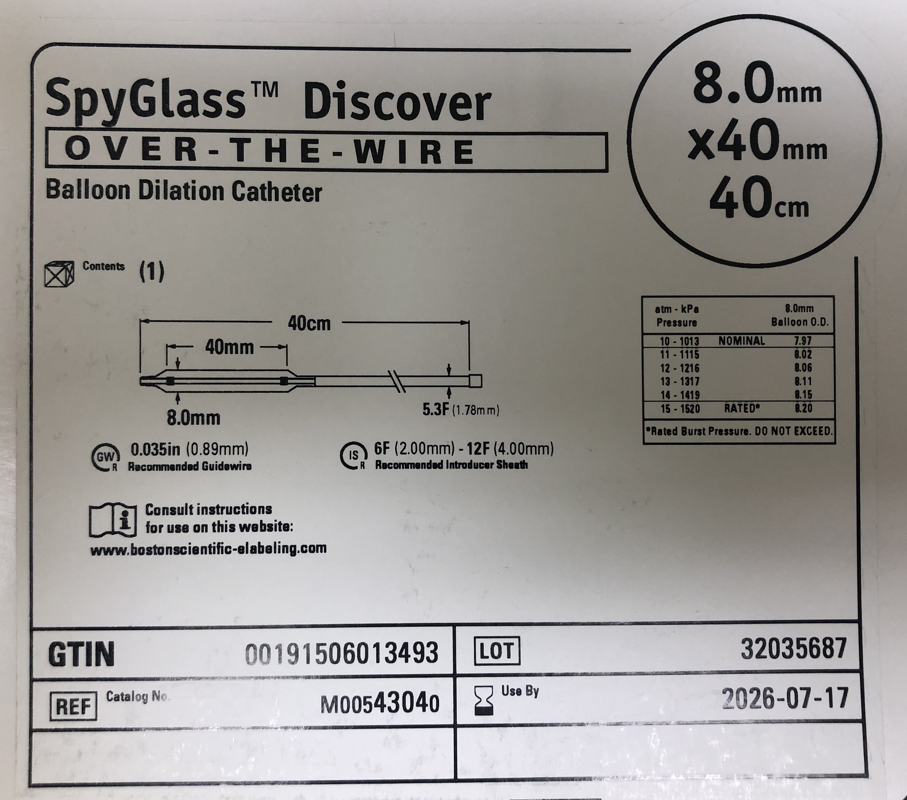
Equipment (2)
Stone-retrieval baskets
Guidewire: 0.035 inches and >90cm long
Over-the wire balloon dilator
IV tubing for saline instillation (we also have foot pedal irrigation control device)
Atraumatic forceps

Slide 8
Equipment (3)
Choledochoscope (spyglass)

Slide 10
Equipment (4)
Second monitor for choledochoscope
Pressurized IV-bag set-up or irrigation pump system
Ligating loop or Hem-o-lok clips

Slide 11
Technique
Robot/laparoscopic approach with identification of cystic duct
Cholangiogram with confirmation of anatomy
Introducer sheath and inner dilator placement midway between the subxiphoid and right midclavicular ports
Advance 0.035” guidewire through the cystic duct into the CBD and duodenum (optional: if unable to pass can use a ureteral stent first through which to advance/place the guidewire)
Over-the-wire balloon dilator (spanning entire cystic duct and cross the cystic duct-common duct junction
- Dilate to 5-8 mm but not more than the diameter of the CBD

Slide 12
Technique (continued)
Remove pneumatic dilator while leaving guidewire in place
Proceed with one or more of the following:
wire basket with fluoroscopy
Fogerty (#4) with fluoroscopy: advance beyond stone, remove wire, inflate, and withdraw
Endoscopy with choledochoscope: preferred approach over the wire, can employ basket through working port
Endoscopy with choledochoscope and lithotripsy
Completion cholangiography
Ligate/clip duct

